Slide 1
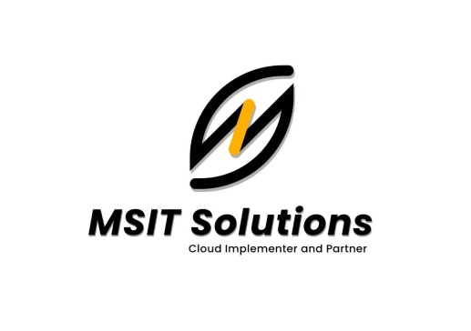
INFRA STRUCTURE
http://msitsolutions.org/

Slide 2
Content
1.What is Infra structure
3
CONTENTS
2.Roles of Infra engineer
4
TABLE OF
3.Resources of Infra structure
7
http://msitsolutions.org/

Slide 3
What is Infra structure
Infra structure Engineer
Infrastructure engineers are professionals who set up and maintain computing infrastructure for various organizations. They play a crucial role in keeping a company's operations and services running efficiently.

Slide 4
Roles of a Infra engineer
1. Conduct a Root Cause Analysis of Network Malfunctions :
A big part of an Infrastructure Engineer’s job is identifying the cause of issues within their employer or client’s network infrastructure. This requires knowledge of how devices communicate with each other.
2. Create and Implement Network Repair Strategies:
Once a problem is identified, the Infrastructure Engineer devises and implements a repair strategy. They then test these repairs to ensure the issue is fixed completely.
http://msitsolutions.org/

Slide 5
3. Document Network Malfunctions and Corresponding Actions Taken :
It is the responsibility of the Infrastructure Engineer to document all infrastructure issues, as well as the actions taken to address said issues. This requires analytical skills and proficiency with spreadsheets.
4. Provide Training and Technical Support for Users With Varying Levels of IT Knowledge :
The Infrastructure Engineer is responsible for teaching new software or applications to their coworkers. They are also responsible for diagnosing and fixing any technical issues with individual devices on their employer’s network.
5. Complete Routine Preventative Maintenance of Network Infrastructure :
This duty is all about network security. This involves implementing software and operating system updates.It also includes looking for and addressing potential cyber security threats.

Slide 6
INDUSTRIAL TRAINING COURSE STRUCTURE FOR INFRA STRUCTURE
http://msitsolutions.org/

Slide 7
Resources of Infra structure
These are some of the resources created by infra engineer:
Creation of vpc :
A virtual private cloud (VPC) is a virtual network dedicated to your AWS account. It is logically isolated from other virtual networks in the AWS Cloud. You can launch your AWS resources, such as Amazon EC2 instances, into your VPC. create as Nat gateway and Internet gate way.
For more information click below link :
https://docs.aws.amazon.com/vpc/latest/userguide/working-with-vpcs.html.
Creation of the subnets :
Public subnet: The route table entries enable instances in the subnet to use IPv4 to communicate with other instances in the VPC, and to communicate directly over the internet. A subnet that's associated with a route table that has a route to an internet gateway is known as a public subnet..
For more information click below link :
https://docs.aws.amazon.com/AmazonECS/latest/developerguide/create-public-private-vpc.html.

Slide 8
Private subnet : A private subnet is a subnet that is associated with a route table that doesn’t have a route to an internet gateway. Instances in the private subnet are backend servers they don’t accept the traffic from the internet.
Db subnet : A DB subnet group is a collection of subnets (typically private) that you create for a VPC and that you then designate for your DB instances.A DB subnet group allows you to specify a particular VPC when you create DB instances using the CLI or API.
For more information click below link:
https://docs.aws.amazon.com/documentdb/latest/developerguide/document-db-subnetgroups.html.

Slide 9
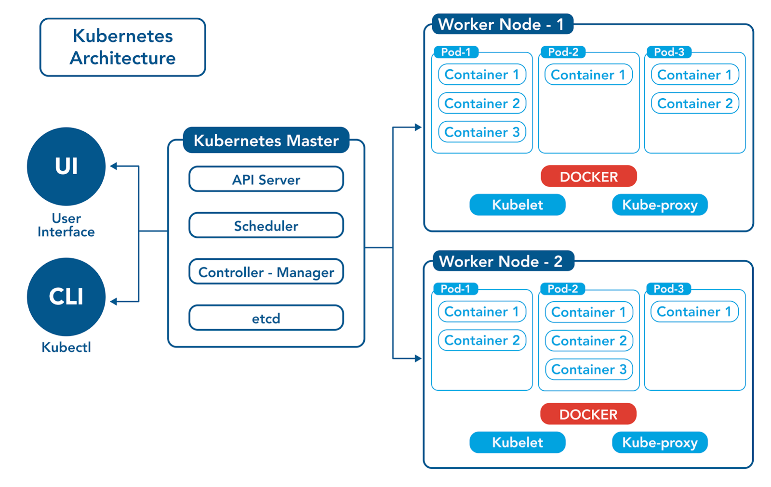
Kubernetes: Kubernetes is a portable, extensible, open-source platform for managing containerized workloads and services, that facilitates both declarative configuration and automation.
For more details click below link:
https://kubernetes.io/.

Slide 10
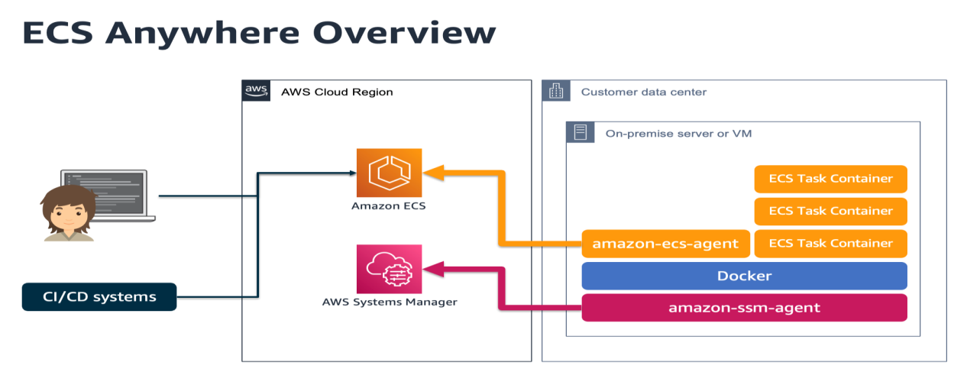
Ecs : Amazon Elastic Container Service (Amazon ECS) is a highly scalable and fast container management service. You can use it to run, stop, and manage containers on a cluster..
For more information click below link :
https://medium.com/expedia-group-tech/elastic-container-service-when-aws-documentation-is-not-enough-d1288bfb89fb.

Slide 11
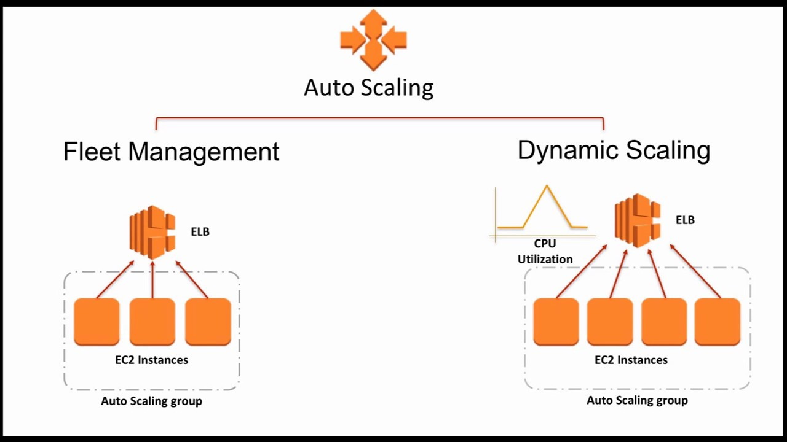
Auto scaling group : autoscalling help to enuse that you have the correct number of instance availably to handle to load for you application your create collections of ec2 instances is called autoscalling group.
For more information click below link :
https://jayendrapatil.com/aws-auto-scaling/.

Slide 12
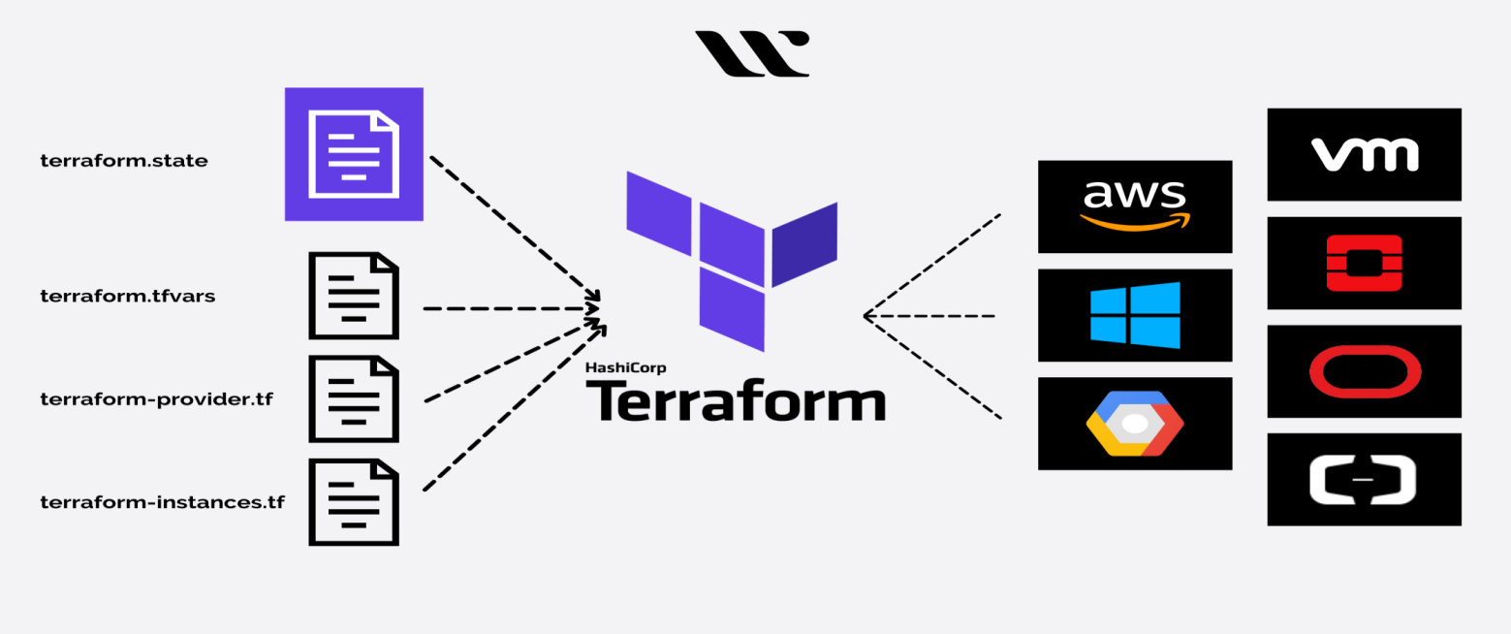
Terraform : It is an infrastructure as code (IaC) tool that allows you to build, change, and version infrastructure safely and efficiently. It allows you to define infrastructure as code for over 1300 cloud services providers , including AWS
For more information click below link :
https://github.com/terraform-docs/terraform-docs

Slide 13
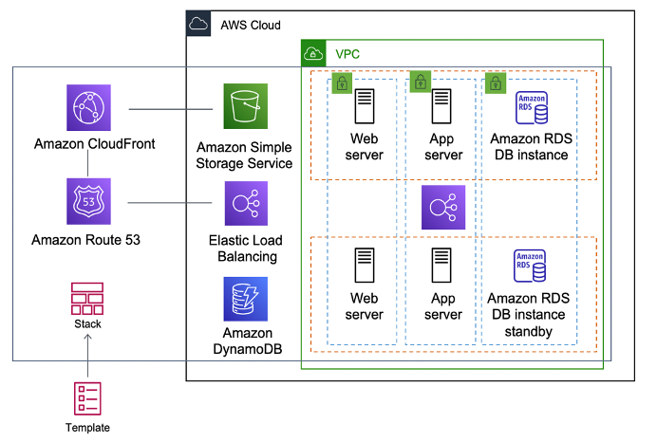
AWS CloudFormation : It is a service that helps you model and set up your AWS resources so that you can spend less time managing those resources and more time focusing on your applications that run in AWS. You create a template that describes all the AWS resources .
For more information click below link :
https://hirelofty.com/blog/devops/automate-your-aws-resources-cloudformation/.

Slide 14
Stateful applications :
A stateful app is a program that saves client data from the activities of one session for use in the next session. The data that is saved is called the application's state. Apps can be stateful or stateless.
Stateless applications :
A stateless app is an application program that does not save client data generated in one session for use in the next session with that client. Each session is carried out as if it was the first time and responses are not dependent upon data from a previous session.

Slide 15



MSIT SOLUTIONS P.V.T L.T.D
CLOUD IMPLEMENTER AND PARTNER
www.msitsolutions.org.
https://www.linkedin.com/company/80361081/admin/.
https://www.instagram.com/msitsolutionscloud/.
https://twitter.com/home.
hr@msitsolutionsgroup.com

